Slide 1
Time Series Basics
BY:
161FA04352
161FA04354

Slide 2
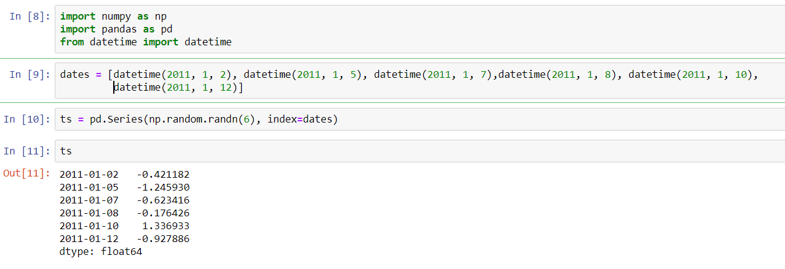
Introduction
The most basic kind of time series object in pandas is a Series indexed by timestamps , which is often represented external to pandas as Python strings or datetime objects
Eg:-

Slide 3
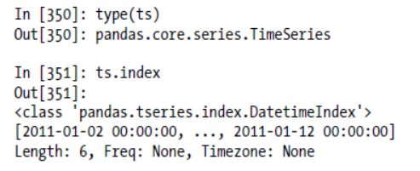
Cont’d
These datetime objects have been put in a DatetimeIndex, and the variable ts is now of type TimeSeries

Slide 4
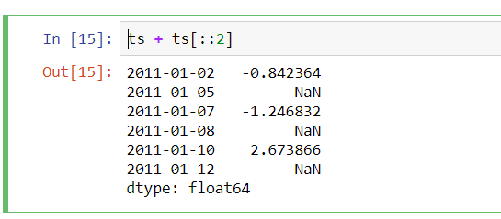
Cont’d
Like other Series, arithmetic operations between differently-indexed time series automatically align on the dates

Slide 5
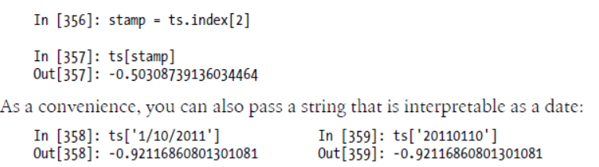
Indexing, Selection, Subsetting
TimeSeries is a subclass of Series and thus behaves in the same way with regard to indexing and selecting data based on label

Slide 6
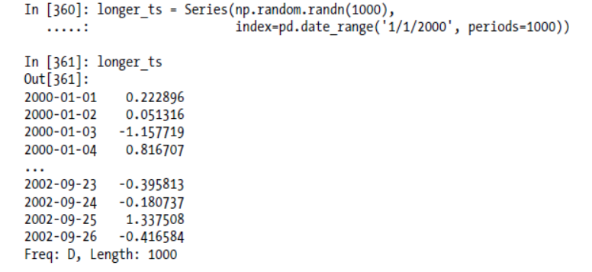
Cont’d

Slide 7
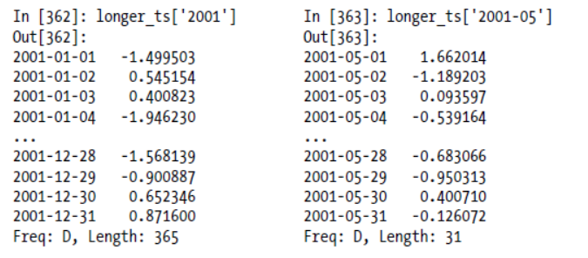
Cont’d

Slide 8
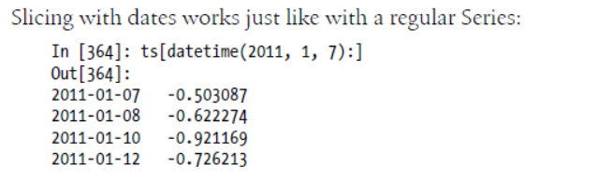
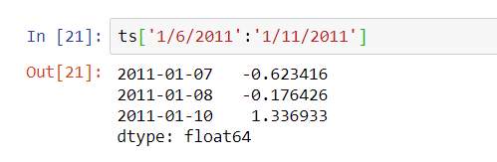
Cont’d

Slide 9
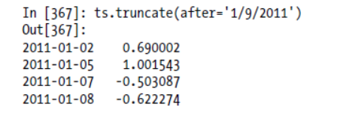
Cont’d
As before you can pass either a string date, datetime, or Timestamp. Remember that slicing in this manner produces views on the source time series just like slicing NumPy arrays. There is an equivalent instance method truncate which slices a TimeSeries between two dates:

Slide 10
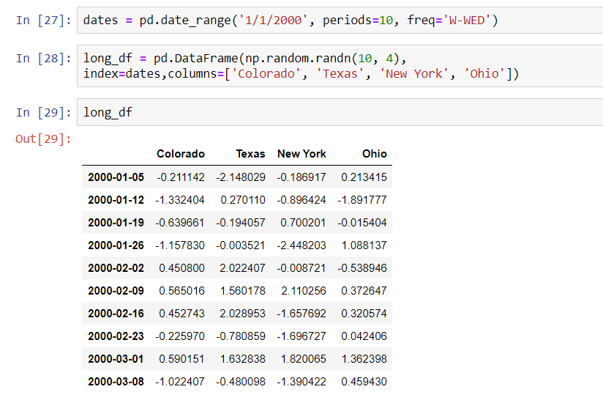
For data frames
All of the above holds true for DataFrame also

Slide 11
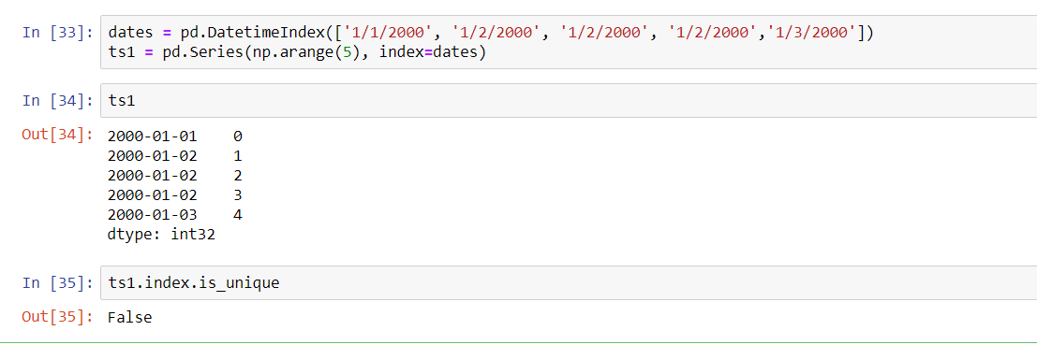
Time Series with Duplicate Indices
In some applications, there may be multiple data observations falling on a particular timestamp
Eg:-

Slide 12
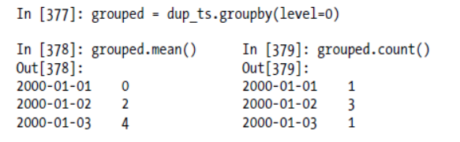
Cont’d
Suppose you wanted to aggregate the data having non-unique timestamps. One way to do this is to use groupby and pass level=0

Slide 13
Date Ranges, Frequencies, and Shifting
Generic time series in pandas are assumed to be irregular; that is, they have no fixed frequency. For many applications this is sufficient. However, it’s often desirable to work relative to a fixed frequency, such as daily, monthly, or every 15 minutes, even if that means introducing missing values into a time series. Fortunately pandas has a full suite of standard time series frequencies and tools for resampling, inferring frequencies, and generating fixed frequency date ranges. For example, in the example time series, converting it to be fixed daily frequency can be accomplished by calling resample

Slide 14
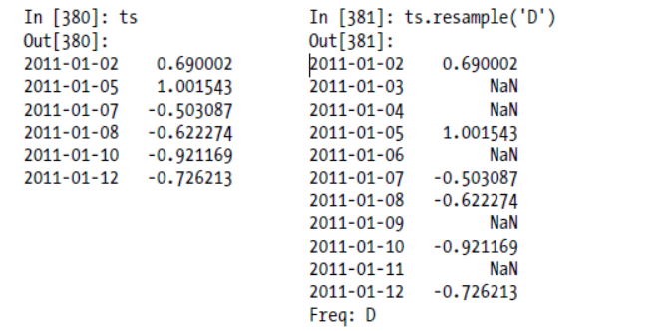
Cont’d
D=Daily frequency

Slide 15
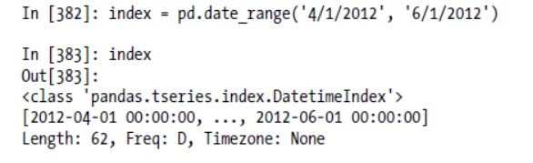
Generating Date Ranges

Slide 16
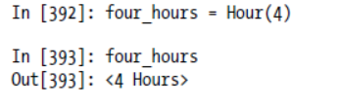
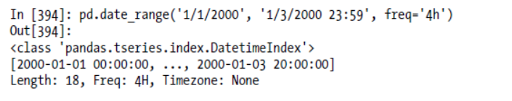
Frequencies and Date Offsets
Frequencies in pandas are composed of a base frequency and a multiplier. Base frequencies are typically referred to by a string alias, like 'M' for monthly or 'H' for hourly.

Slide 17
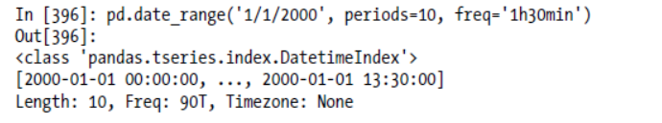
Cont’d

Slide 18
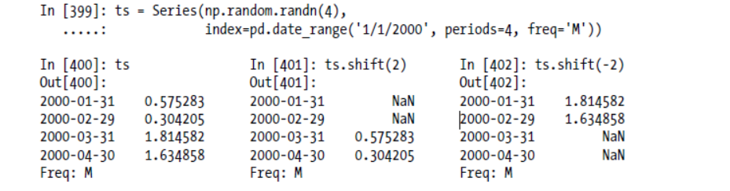
Shifting (Leading and Lagging) Data
“Shifting” refers to moving data backward and forward through time. Both Series and DataFrame have a shift method for doing naive shifts forward or backward, leaving the index unmodified:

